Slide 1
SMSA miniproject
Manos Dimogerontakis

Slide 2
The goal was to recreate a monophonic drum recording into a modular synthesizer.
NMF was used as the decomposition method.
The production of the NMF outputs 2 kinds of matrices, with the information of the time envelopes and the spectral envelopes per source.

Slide 3

The NMF tries to ‘form’ W and H matrices knowing the V spectrogram.
NMF tries to minimize the divergence (or the error) between V and WH.
Famous choice for D is the β-divergence. Which, includes 3 choices (Euclidean, KL, and IS).
Depending on the type of signal we can choose between them.

Slide 4
Because of the non-closed form solution we need to solve it iteratively.
Most common solution is the multiplicative gradient descent.

Slide 5
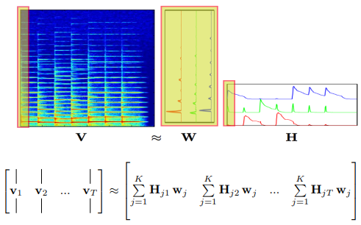

Slide 6
